Slide 1

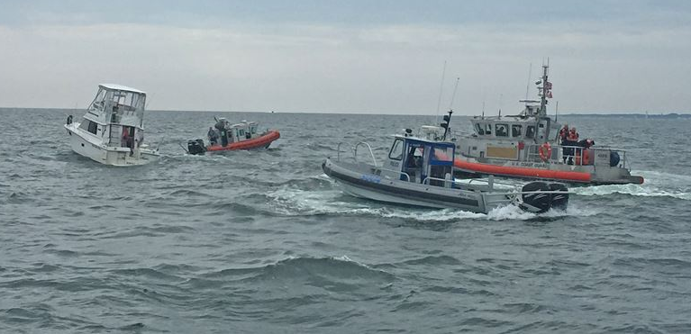
Recreational Boating Accidents:
Causes, Insights, and Ways to Improve Boater Safety
Analysis by Ralph Parlin

Slide 2
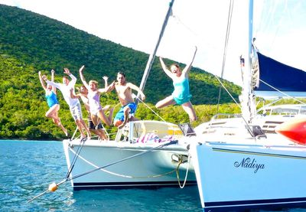
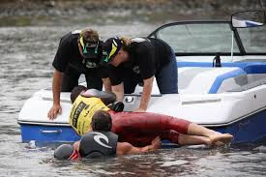
The Two Sides of Boating
Recreational boating is one of America’s favorite pastimes.
Annual economic impact of recreational boating averages around $170.3 billion a year.
Supports more that 691,149 workers and 35,277 business.
~141.6 million Americans go boating each year.
2018 there were nearly 5000 boating accidents on US waters.
Resulting in:
$46 million worth of damages
Over 600 deaths
Over 2,500 serious injuries.
Notes:
Recreational boating is one of America’s favorite pastimes.
Annual economic impact of recreational boating averages around $170.3 billion a year.
It also supports more that 691,149 workers and 35,277 business. It is estimated that 141.6 million Americans go boating each year.
However, being on the water, although fun, is also dangerous. In 2018 there were over 4,415 boating accidents on US waters. These accidents resulted in $45.9 million worth of damages, and more importantly, lead to 633 deaths and 2,511 serious injuries.

Slide 3
Recreational Boating Accidents
Purpose & Agenda
Purpose
This brief is to offer an executive level overview of an analysis on recreational boating accidents by exploring Coast Guard Data from 2017 to 2019
Agenda
Project Summary
Research Questions
Data Summary and Treatment
Exploratory Data Analysis
Modeling
Conclusion & Recommended Future Study

Slide 4
Recreational Boating Accidents
Project Summary
Project Objective:
Better understand the ecosystem of boating accidents. What sort of accidents occur, why do they happen, how can model be developed that help inform/predict the cost of accidents, and predict if an accident is likely to result in death.
Data:
Provided by U.S. Coast Guard
Access Database file for years 2017 and 2018; multiple tables
Queried, Normalized and exported to csv
Key Metric:
Total Damage ($)
Death (1/0)
Approach:
Through descriptive statistics, visualizations, and modelling, identify key differentiating features that help explain the variance in boating accidents costs – both financial and human lives.

Slide 5
Recreational Boating Accidents
Research Questions
Questions that focused the analysis:
What underlie patterns exist in the data? Is there something there that we can’t see? How can the data be clustered/assigned persona? [Cluster Analysis]
Which boating accident factors are significant when trying to predict the financial cost of accidents? [OLS Regression Analysis]
How do we best predict if an accident will result in Death? [Decision Tree Classification]

Slide 6
Recreational Boating Accidents
Data Summary
The Data
Report data collected by the U.S> Coast Gurad from 2017 to 2019
11, 720 observations across 35 columns, numeric and categorical features
Treatment for Missing Data
Total of 85,183 missing values, 11,534 records with missing data and 13 columns with missing data
Moving the database to 2nd normal form created may of these missing values
Not all accidents had deaths, so CauseofDeath would be null
Clean-up began with fields common to all boating reports – using mean and mode as appropriate depending on the distribution of the data
For categorical features I recorded NAs as “Unknown” rather than use mode interpolation. Consistent with field reporting best practice.
Features missing data conditional on the outcome of the event, e.g. Death, filtering with conditional statement to replace missing values was conducted
Example logic: “if death = yes, are there NAs? If yes replace with mean, otherwise skip”

Slide 7
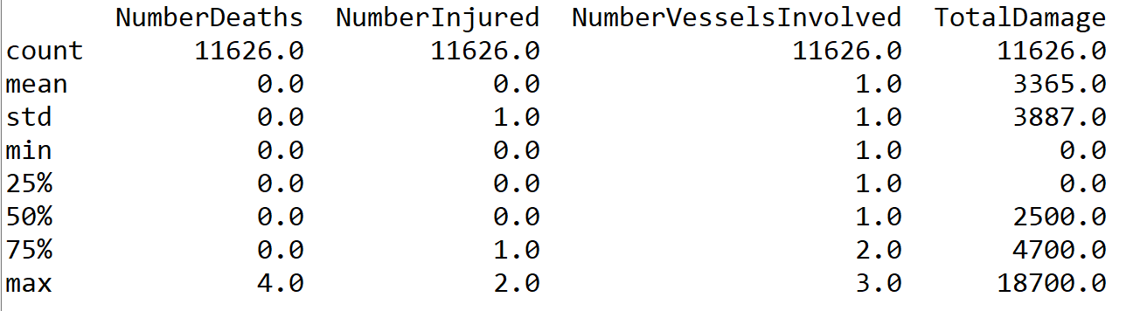
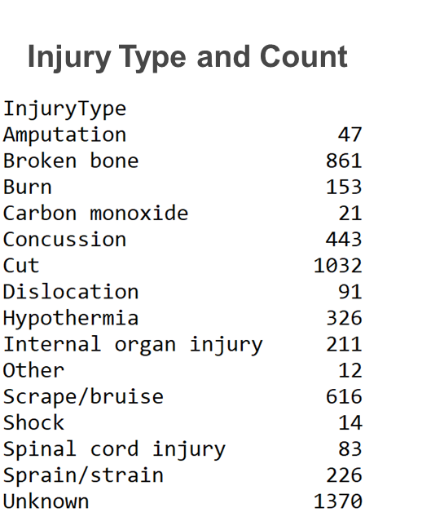
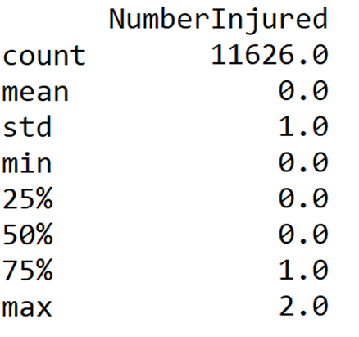

Recreational Boating Accidents
Exploratory Data Analysis (1 of 3)

Slide 8
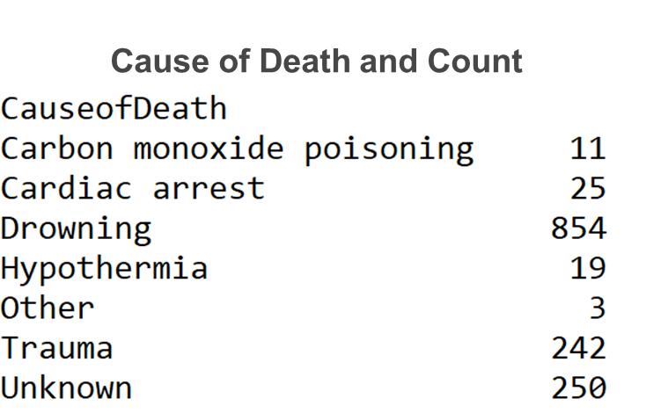

Recreational Boating Accidents
Exploratory Data Analysis (2 of 3)

Slide 9
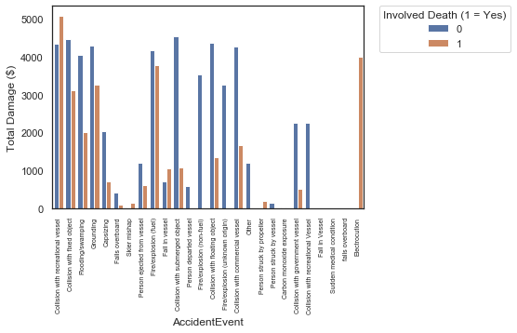
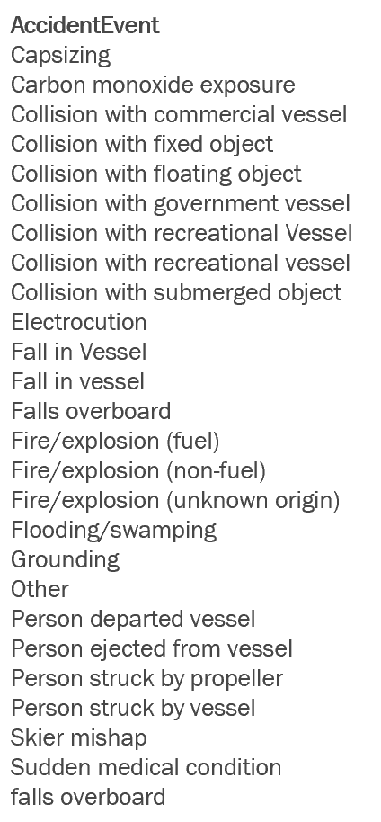
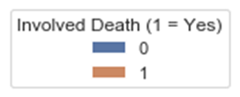
Recreational Boating Accidents
Exploratory Data Analysis (3 of 3)

Slide 10
Recreational Boating Accidents
Modeling and Prediction (1 of 3)
Cluster Analysis

Slide 11
Recreational Boating Accidents
Modeling and Prediction (2 of 3)
Linear Model (Multi-variate Regression)

Slide 12
Recreational Boating Accidents
Modeling and Prediction (3 of 3)
Classification Decision Tree

Slide 13
Recreational Boating Accidents
Conclusion
Conclusion & Recommended Future Study
Increase the time period for survey data collection to get a better representative sample of customer perceptions
The current survey only collects data for two months. Furthermore, this data was collected over the winter timeframe which includes weather patterns that often lead to flight delays; particularly for airlines operating in north/north east parts of the US

Slide 14
Accident Events, Damages and Death Status

Slide 15
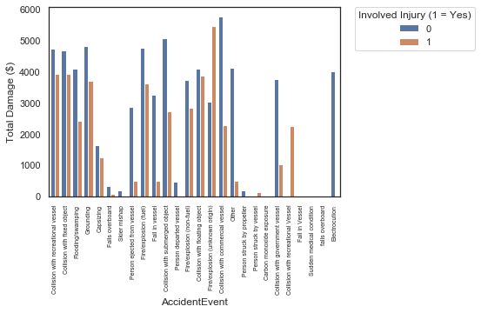
Accident Events, Damages and Injury Status

Slide 16
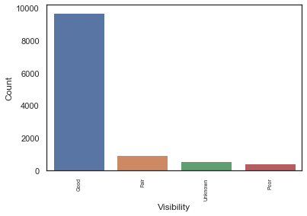
Visibility

Slide 17
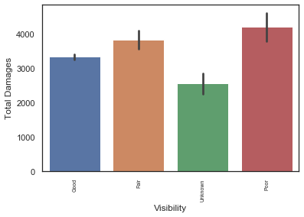
Visibility and Damages

Slide 18
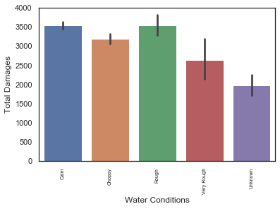
Water Conditions and Damages

Slide 19
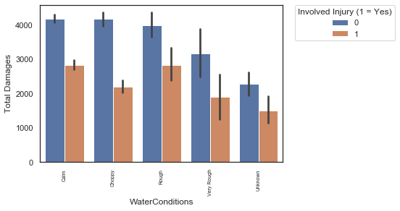
Water Conditions and Damages and Injury

Slide 20
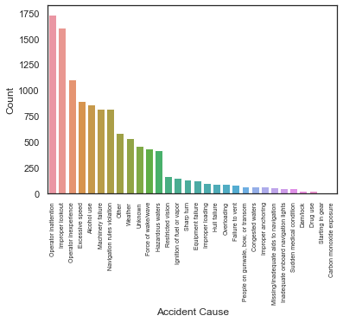
Accident Cause and Count

Slide 21
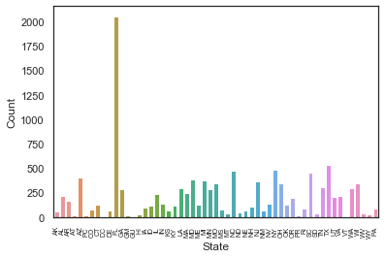
Accident Count by State

Slide 22
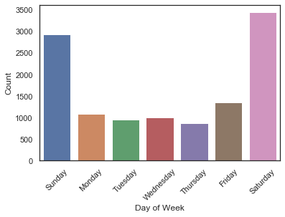
Accident Count by Day of the Week

Slide 23
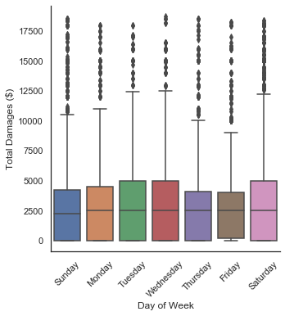
Accident Count by Day of the Week
and Damages Distribution

Slide 24
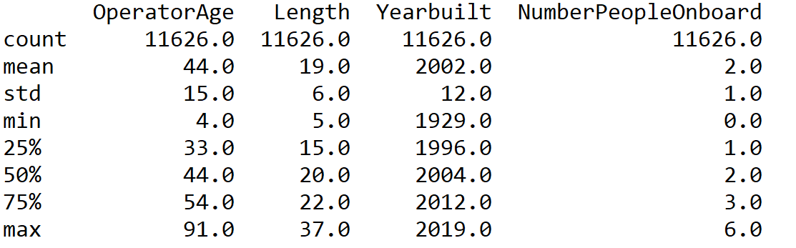
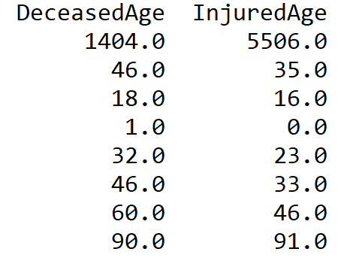
Accident Count by Day of the Week
and Damages Distribution

Slide 25
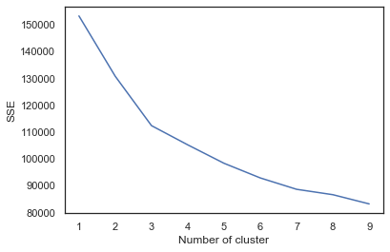

Slide 26
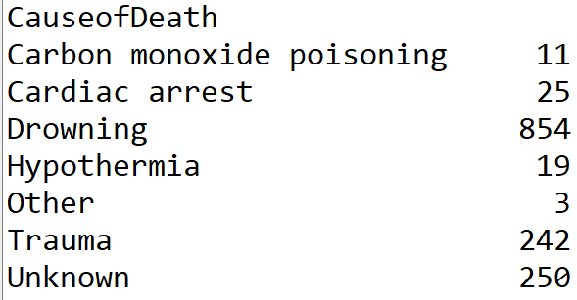
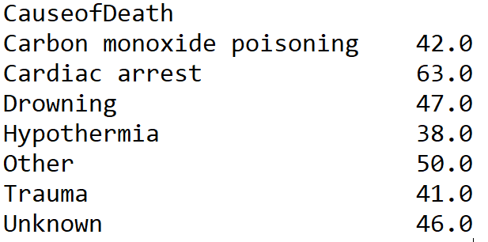
Cause of Death and Avg
Age of Deceased
Cause of Death and Count

Slide 27
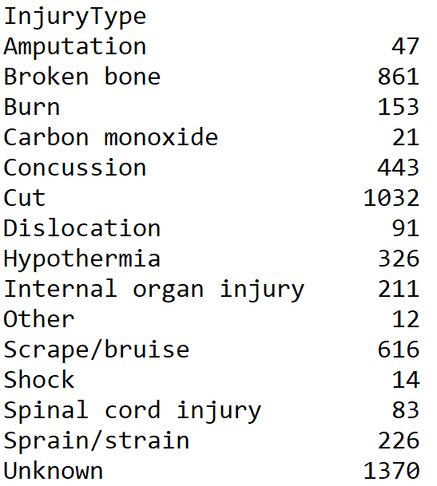
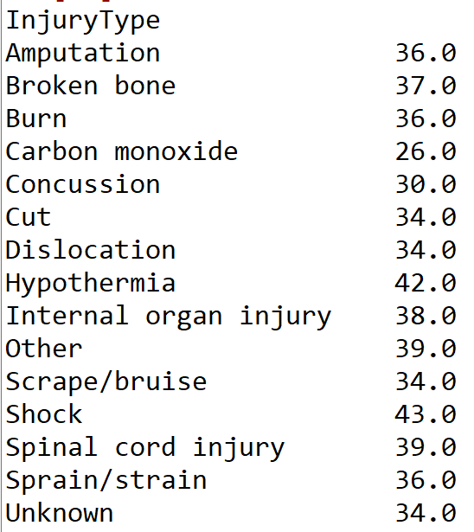
Injury Type and Avg
Age of Deceased
Injury Type and Count

Slide 28
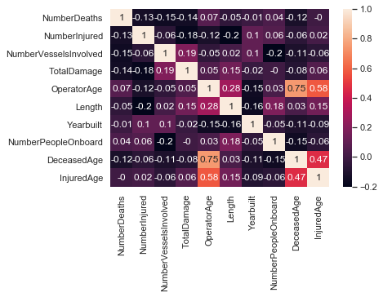
Correlation Matrix

Slide 29
Death (1 = Yes) | 0 | 1
Cluster
0 | 5040 | 0
1 | 5182 | 0
2 | 0 | 1404
Injury(1 = Yes) | 0 | 1
Cluster
0 | 0 | 5040
1 | 5074 | 108
2 | 01046 | 358
Day (1 = Yes) | 0 | 1
Cluster
0 | 784 | 4256
1 | 964 | 4218
2 | 366 | 1038
WaterConditions_Rough | 0 | 1
Cluster
0 | 4747 | 293
1 | 4746 | 436
2 | 1238 | 166
Visibility_Poor | 0 | 1
Cluster
0 | 4876 | 164
1 | 4986 | 196
2 | 1335 | 69

Slide 30
DTC Confusion Matrix
 | No Death | Death
True No Death | 2872 | 188
True Death | 172 | 256

Slide 31
